Slide 1
DATA 601 – Make
Felix Gonzalez

Slide 2
Make
Make is a versatile tool which can run commands
Some examples
Compile source code into executable programs or libraries
Run scripts on data files to get summaries or plots
Parse and combine text files and plots to create paper
Make is designed to only update files when they need to be. It tracks the dependencies between files it creates, and files used to create them.
Read
Output
Process

Slide 3
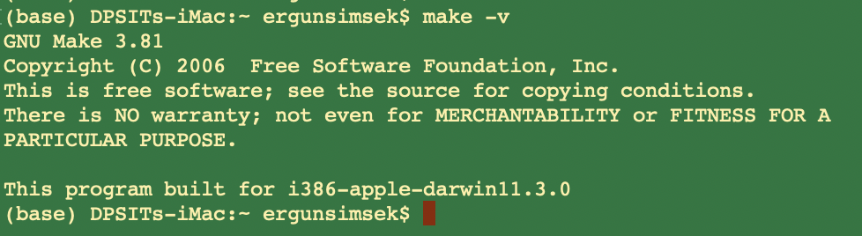
Setup
Make is already available in Unix machines
On Macs, make comes with Xcode
For Windows, I have no clue
https://github.com/swcarpentry/windows-installer
Open a terminal and check whether you have it
make -v

Slide 4
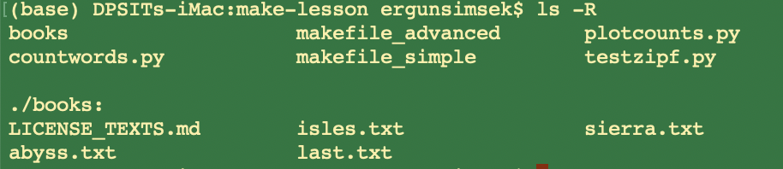
Example
Let’s look at our folder
We have 3 *.py codes
We have a subfolder called “books” which has some *.txt files

Slide 5
countwords.py
import sys
# bunch of functions
# bunch of functions
# …
# at the end, we have the following lines. EXAMINE!!
if __name__ == '__main__':
input_file = sys.argv[1]
output_file = sys.argv[2]
min_length = 1
if len(sys.argv) > 3:
min_length = int(sys.argv[3])
word_count(input_file, output_file, min_length)

Slide 6
testzipf.py
Warning
from countwords import load_word_counts
import sys
def top_two_word(counts):
"""
Given a list of (word, count, percentage) tuples,
return the top two word counts.
"""
limited_counts = counts[0:2]
count_data = [count for (_, count, _) in limited_counts]
return count_data
if __name__ == '__main__':
input_files = sys.argv[1:]
print("Book\tFirst\tSecond\tRatio")
for input_file in input_files:
counts = load_word_counts(input_file)
[first, second] = top_two_word(counts)
bookname = input_file[:-4]
print("%s\t%i\t%i\t%.2f" %(bookname, first, second, float(first)/second))

Slide 7
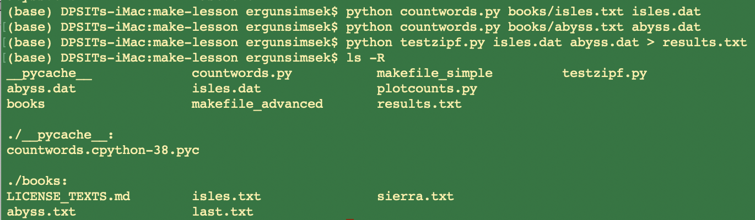
Example
The Python program “countwords.py” counts the frequency of each word in a text file.
We want to out the frequency of words in “x.txt” to a new data file “x.dat”
Then we want to use the “testzipf.py” to test the “Zipf’s Law” on the “x.dat”
In a terminal, we can
achieve this in 3 steps
WHAT IF YOUR TASK IS RUNNING THESE CODES FOR THOUSANDS OF BOOKS?
Notes:
Zipf’s Law: the frequency of any word is inversely proportional to its rank in the frequency table. Thus the most frequent word will occur approximately twice as often as the second most frequent word, three times as often as the third most frequent word, etc.

Slide 8

Example Cont.
We can create a Makefile to automate processing of the texts.
Let us create a new file called “makefile” (no extension) with the following content:
target and dependency are separated by :
“#” denotes a comment
dependency
target
ACTION
tab
(not 8 spaces)
dependency
target
To take action, simply enter “make” in the terminal

Slide 9

Phony Targets
Suppose we only care about the “results.txt”, hence we want to remove all our data files *.dat, when we are done with counting
We can introduce a new target “clean,” and associated cleaning rule, to the end of our Makefile.
Here, the target “clean” is “.PHONY” in the sense that it doesn’t refer to a name of file. it is just a name for a recipe to be executed when you make an explicit request.
-f: ignore non-existing files

Slide 10
Commands
$ make
python ../countwords.py ../books/abyss.txt abyss.dat
$ ls
abyss.dat isles.dat makefile
$ make clean
rm -f *.dat
$ ls
makefile
# input
# input
# input
# input

Slide 11
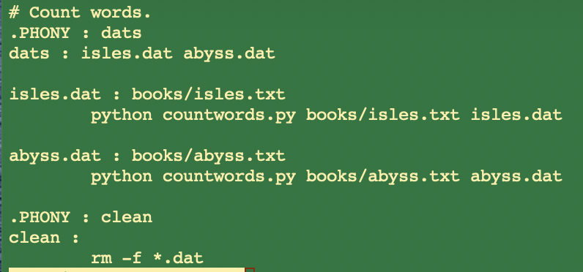
Multiple Targets
As the Makefile gets larger, there may be a variety of data file targets that we would like to be able to build all at once.
One way of doing this would be with a phony target “dats” which depends on all of the targets we want to build.
Let’s put the following at the beginning of the Makefile so that it is the default target.

Slide 12
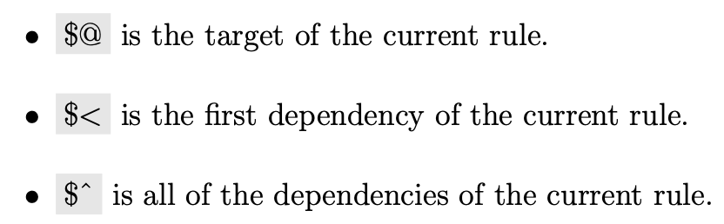
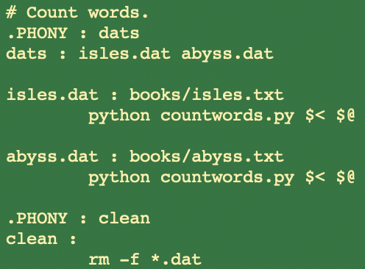
Automation (Step 1)
Automatic variables are reserved expressions for targets and dependencies to be used within rules.

Slide 13
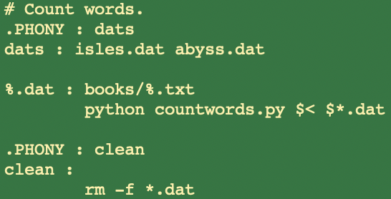
Automation (Step 2: Pattern Rules)
Our Makefile still has repeated content. Specifically, the rules for each data file are identical except for the book name.
We can replace these rules with a single pattern rule.
This rule specifies how to build any data file from a text file in the books directory:

Slide 14
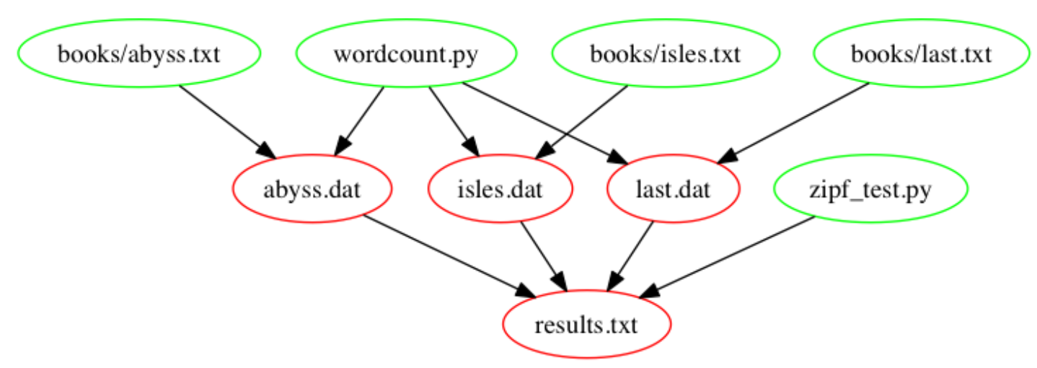
Process, Build Results, Clean the Mess!
countwords.py
testzipf.py

Slide 15
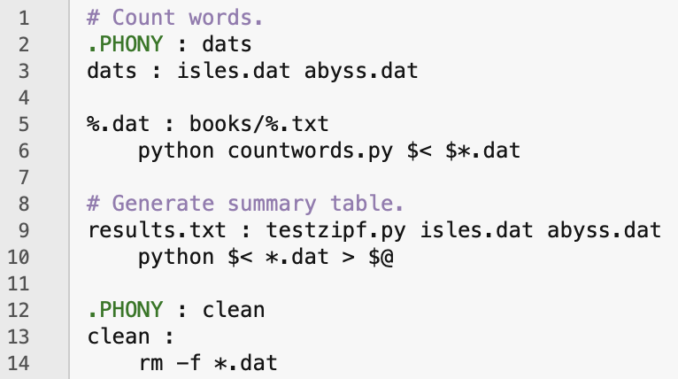
Make: Build Results

